Slide 1
Hypertextual Prototype
Welcome view
Userlogindone view
Group view
Userprofile view
Addpublication view
Settingaccount view
Signup view

Slide 2
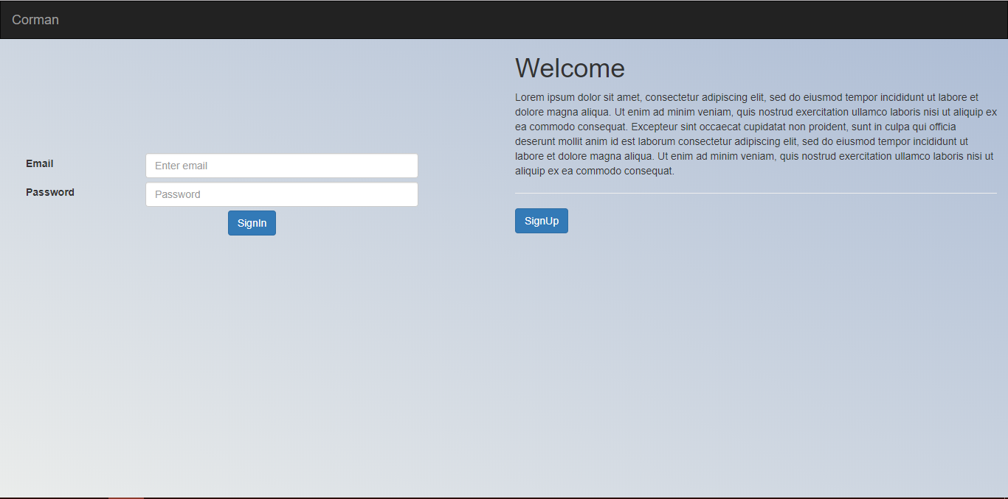



WELCOME

Slide 3
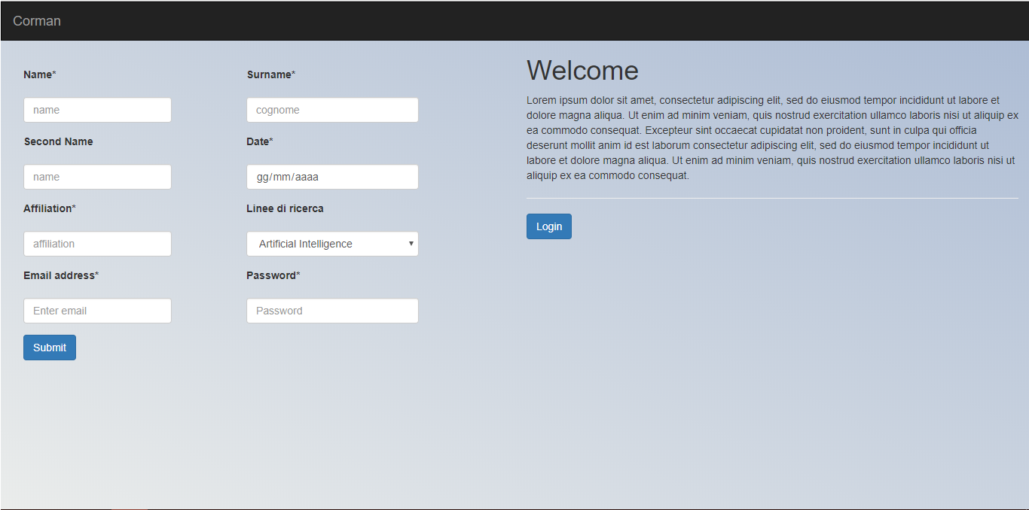



SIGNUP

Slide 4
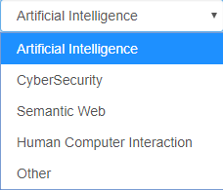
SIGNUP

Slide 5
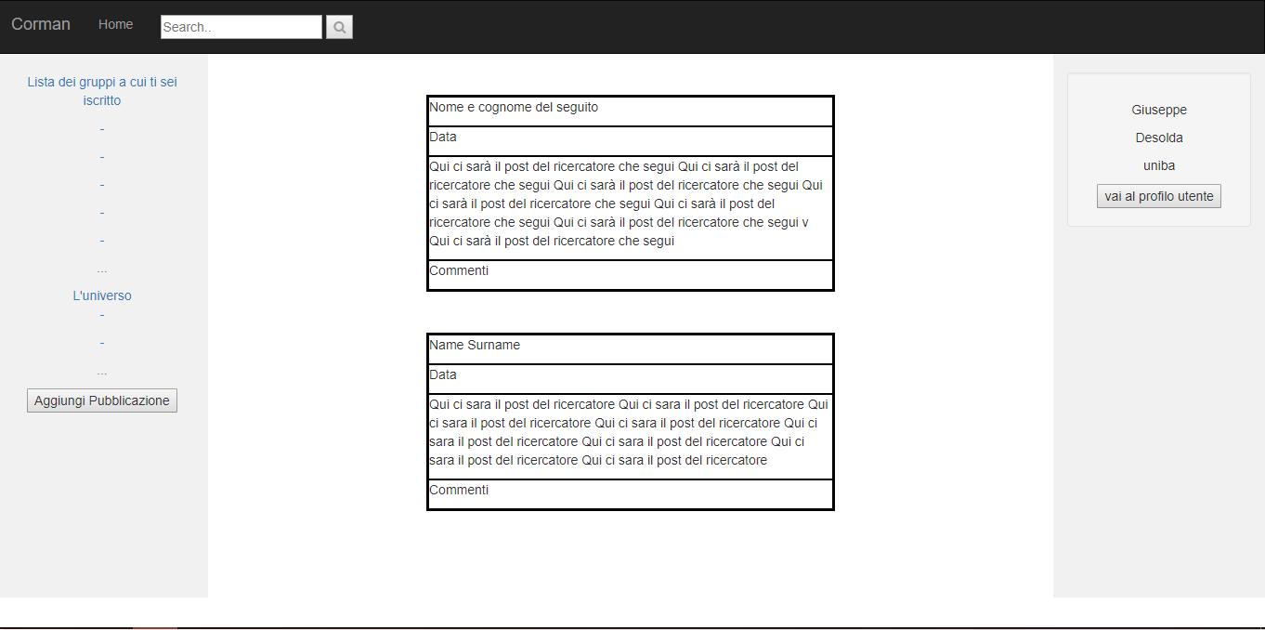



USERLOGINDONE

Slide 6
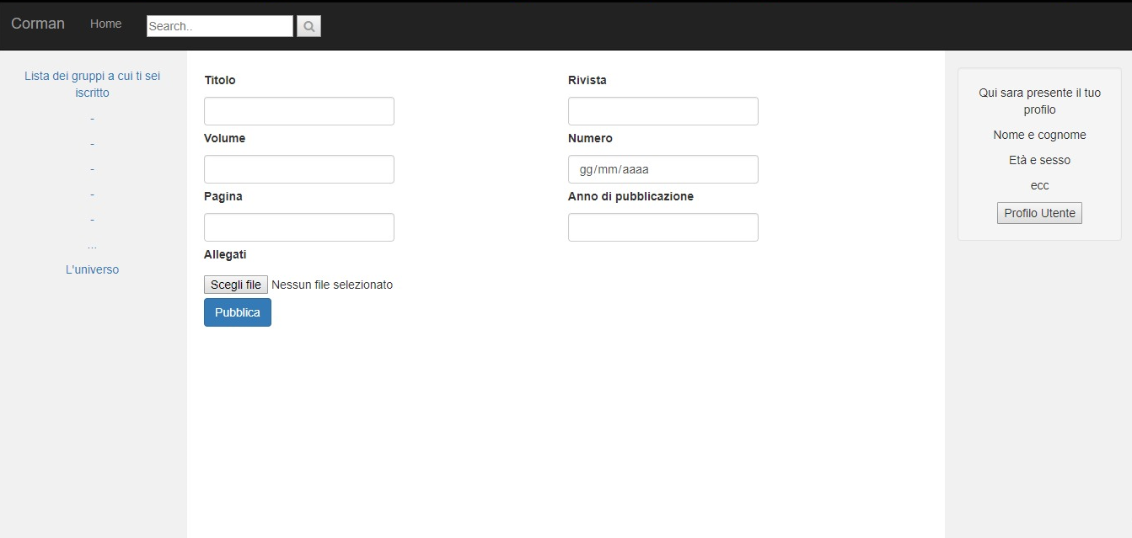

ADDPUBLICATION

Slide 7
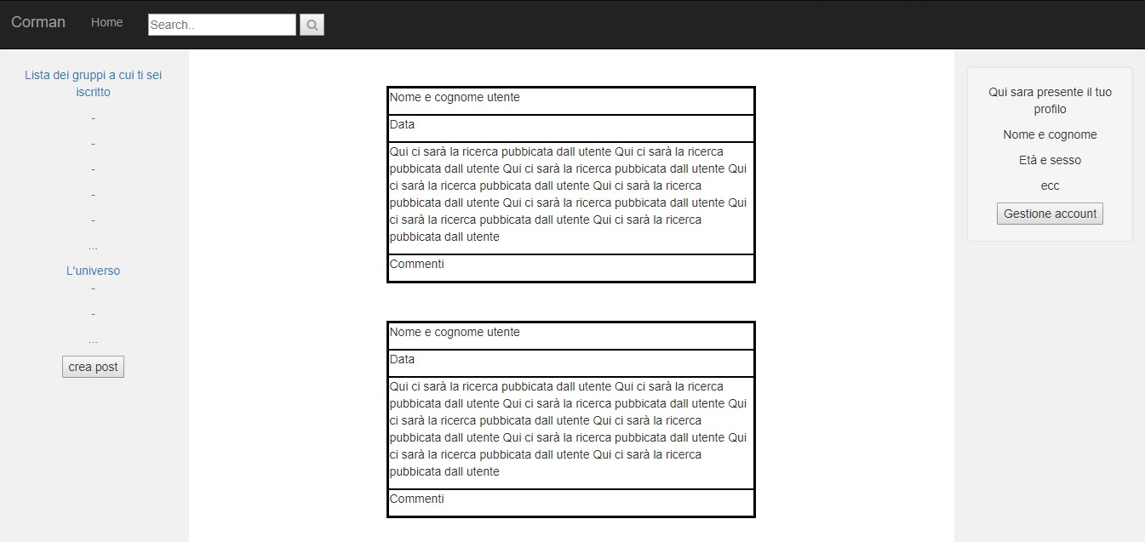

USERPROFILE

Slide 8
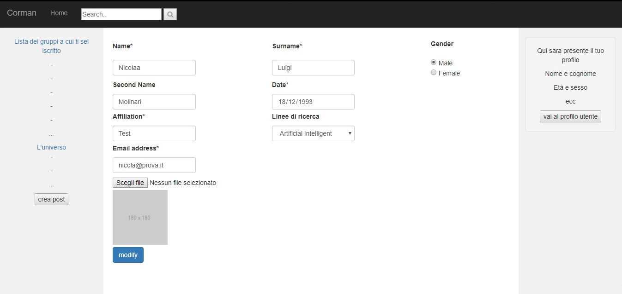

SETTINGACCOUNT

Slide 9
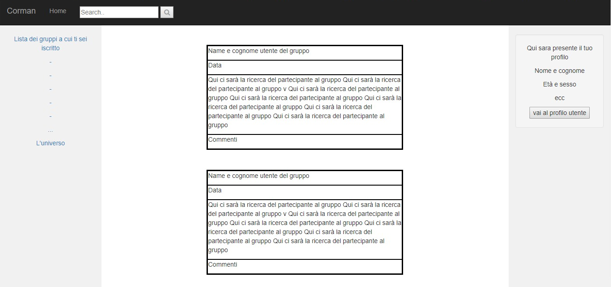
GROUP

Slide 10


WORK IN PROGRESS

